Slide 1



Slide 2



01CE1503 - Design and Analysis of Algorithm
Unit - 2
Divide and Conquer
Prof. MITUL N. TAKODARA
Computer Engineering Department

Slide 3



OUTLINE
Introduction
Problem Solving using divide and conquer algorithm
Binary Search
Multiplying large Integers Problem,
Sorting Algorithms (Merge Sort , Quick Sort)
Max-Min problem
Matrix Multiplication
Exponential

Slide 4
INTRODUCTION
A divide and conquer is a strategy of solving a large problem by
Divide: Divide the given problem into sub-problems using recursion.
Conquer: Solve the smaller sub-problems recursively. If the sub problem is small enough, then solve it directly.
Combine: Combine the solutions of the sub-problems that are part of the
recursive process to solve the actual problem.

Slide 5
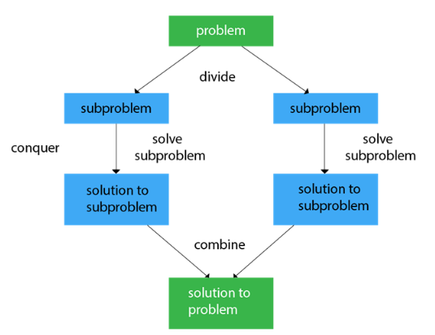
INTRODUCTION

Slide 6
BINARY SEARCH
Binary search is used to search the particular element in the list.
If the element is present in the list, then the process is called successful, and the process returns the location of that element. Otherwise, the search is called unsuccessful.
Binary search follows the divide and conquer approach in which the list is divided into two halves, and the item is compared with the middle element of the list.
If the match is found then, the location of the middle element is returned. Otherwise, we search into either of the halves depending upon the result produced through the match.
Note: Binary search can be implemented on sorted array elements. If the list elements are not arranged in a sorted manner, we have first to sort them.

Slide 7




BINARY SEARCH
int bs(int arr[ ], int l, int h, int key)
{
if (l <= h)
{
int mid = (l + h) / 2;
if (arr[mid] == key)
return mid;
if (key<arr[mid])
return bs(arr, l, mid - 1, key);
else
return bs(arr, mid + 1, h, key);
}
return -1;
}

Slide 8
Multiplying large Integers Problem
This problem can be solved with the help of divide and conquer technique.
For example: consider multiplication of two integers 42 and 34.
First let us represent these numbers according to positions.

Slide 9
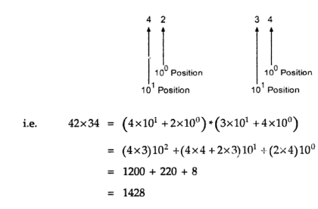
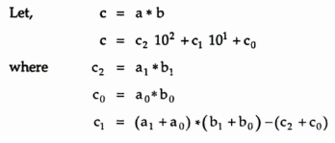
Multiplying large Integers Problem

Slide 10
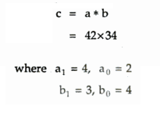
Multiplying large Integers Problem

Slide 11
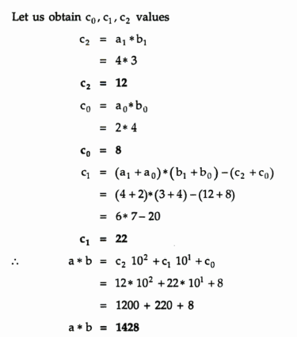
Multiplying large Integers Problem

Slide 12
Multiplying large Integers Problem
We can generalize this formula as-
If size of integer is n digit, then we can generalize multiplication as,
C=a*b
C = c₂10^{n} + c₁10^{n/2} + c₀
Where,
c₂ = a₁ * b₁
c₀ = a₀*b₀
c₁ = (a₁ + a₀) * (b₁ + b₀) – (c₂ + c₀)
This can be solved by applying recursion till n reaches to 1.

Slide 13
MERGE SORT
Merge sort is yet another sorting algorithm that falls under the category of Divide and Conquer technique. It is one of the best sorting techniques that successfully build a recursive algorithm.
It works by recursively dividing the array into two equal halves, then sort them and combine them.

Slide 14
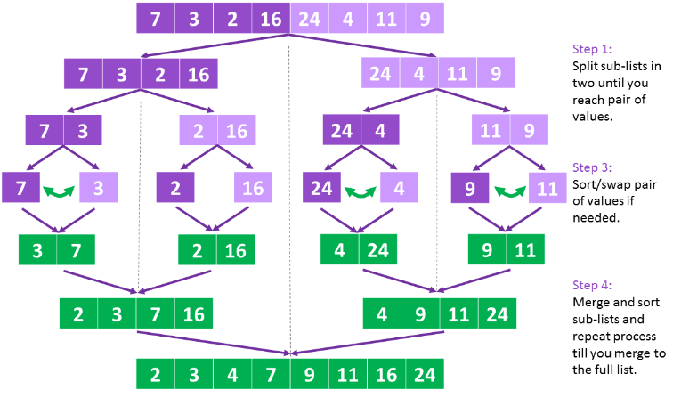
MERGE SORT

Slide 15
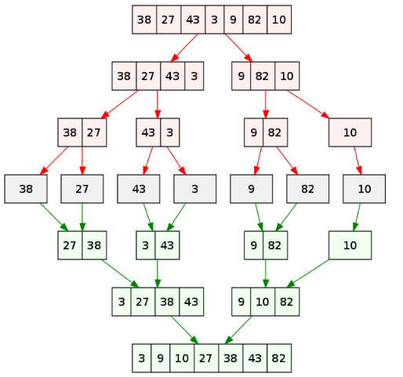
MERGE SORT

Slide 16
MERGE SORT
Algorithm MS(A[0..n-1],low, high)
{
If(low<high) then
{
mid = (low+high)/2
MS(A,low,mid)
MS(A, mid+1, high)
Combine(A,low,mid,high)
}

Slide 17
MERGE SORT
Algorithm combine(A,low,mid,high)
{
k 🡨 low
i 🡨 low
j 🡨 mid+1
while ( i <= mid and j <= high) do
{
if(A[ i ] <= A[ j ] ) then
{
temp[ k ]🡨A[ i ]
i++
k++
}
else
{
temp[ k ]=A[ j ]
j++
k++
}
}

Slide 18
MERGE SORT
//copy left sub list
while ( i <= mid) do
{
temp[ k ]🡨A[ i ]
i++
k++
}
//copy right sub list
while ( j <= high) do
{
temp[ k ]🡨A[ j ]
j++
k++
}

Slide 19
QUICK SORT
Quick sort is a fast sorting algorithm used to sort a list of elements.
The quick sort algorithm attempts to separate the list of elements into two parts and then sort each part recursively. That means it use divide and conquer strategy.
In quick sort, the partition of the list is performed based on the element called pivot.
Here pivot element is one of the elements in the list.
The list is divided into two partitions such that "all elements to the left of pivot are smaller than the pivot and all elements to the right of pivot are greater than or equal to the pivot".

Slide 20
QUICK SORT
In Quick sort algorithm, partitioning of the list is performed using following steps...
Step 1 - Consider the first element of the list as pivot (i.e., Element at first position in the list).
Step 2 - Define two variables i and j. Set i and j to first and last elements of the list respectively.
Step 3 - Increment i until pivot >= A[i] then stop.
Step 4 - Decrement j until pivot<= A[j] then stop.
Step 5 - If i < j then exchange A[i] and A[j].
Step 6 - Repeat steps 3,4 & 5 until i > j.
Step 7 - Exchange the pivot element with A[j] element.

Slide 21


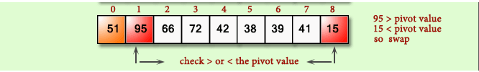

QUICK SORT

Slide 22



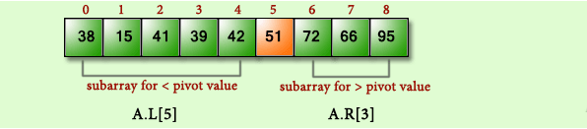
QUICK SORT

Slide 23
QUICK SORT
void quickSort(int arr[ ], int low, int high)
{
if (low < high)
{
int pivot = partition(arr, low, high);
quickSort(arr, low, pivot - 1);
quickSort(arr, pivot + 1, high);
}
}
int partition(int arr[ ], int low, int high)
{
int i = low;
int j = high;
int pivot = arr[low];
while (i < j)
{
while (pivot >= arr[i])
i++;
while (pivot < arr[j])
j--;
if (i < j)
swap(arr[i], arr[j]);
}
swap(arr[low], arr[j]);
return j;
}

Slide 24
MAX-MIN PROBLEM
Max-Min problem is to find a maximum and minimum element from the given array. We can effectively solve it using divide and conquer approach.
In the traditional approach, the maximum and minimum element can be found by comparing each element and updating Max and Min values as and when required.
This approach is simple but it does (n – 1) comparisons for finding max and the same number of comparisons for finding the min. It results in a total of 2(n – 1) comparisons.
Using a divide and conquer approach, we can reduce the number of comparisons.

Slide 25
MAX-MIN PROBLEM
Algorithm MaxMin(a, n, max, min)
{
max=min=a[0];
for i = 1 to n-1 do
{
if (a[i] > max) then
max=a[i];
if (a[i] < min) then
min=a[i];
}
return (max, min);
}

Slide 26
MAX-MIN PROBLEM
Divide and conquer approach for Max. Min problem works in three stages.
If a1 is the only element in the array, a1 is the maximum and minimum.
If the array contains only two elements a1 and a2, then the single comparison between two elements can decide the minimum and maximum of them.
If there are more than two elements, the algorithm divides the array from the middle and creates two sub problems. Both sub problems are treated as an independent problem and the same recursive process is applied to them. This division continues until sub problem size becomes one or two.
After solving two sub problems, their minimum and maximum numbers are compared to build the solution of the large problem.
This process continues in a bottom-up fashion to build the solution of a parent problem.

Slide 27
MAX-MIN PROBLEM
Algorithm DC_MAXMIN (A, low, high)
if n == 1 then
return (A[0], A[0])
else if n == 2 then
if A[0] < A[1] then
return (A[0], A[1])
else
return (A[1], A[0])
else
mid ← (low + high) / 2
[LMin, LMax] = DC_MAXMIN (A, low, mid)
[RMin, RMax] = DC_MAXMIN (A, mid + 1, high)
if LMax > RMax then
// Combine solution
max ← LMax
else
max ← RMax
end
if LMin < RMin then
// Combine solution
min ← LMin
else
min ← RMin
end
return (min, max)
end

Slide 28
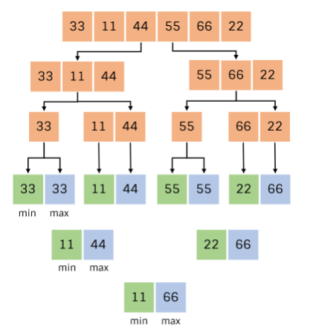
MAX-MIN PROBLEM

Slide 29
MAX-MIN PROBLEM
Complexity analysis
The conventional algorithm takes 2(n – 1) comparisons in worst, best and average case.
DC_MAXMIN does two comparisons to determine the minimum and maximum element and creates two problems of size n/2, so the recurrence can be formulated as
T(n) = 0, if n = 1
T(n) = 1, if n = 2
T(n) = 2T(n/2) + 2, if n > 2
Let us solve this equation using interactive approach.
T(n) = 2T(n/2) + 2 … (1)
By substituting n by (n / 2) in Equation (1)

Slide 30
MAX-MIN PROBLEM
T(n/2) = 2T(n/4) + 2
⇒ T(n) = 2(2T(n/4) + 2) + 2
= 4T(n/4) + 4 + 2 … (2)
By substituting n by n/4 in Equation (1),
T(n/4) = 2T(n/8) + 2
Substitute it in Equation (1),
T(n) = 4[2T(n/8) + 2] + 4 + 2
= 8T(n/8) + 8 + 4 + 2
= 2^3 T(n/2^3) + 2^3 + 2^2 + 2^1

Slide 31
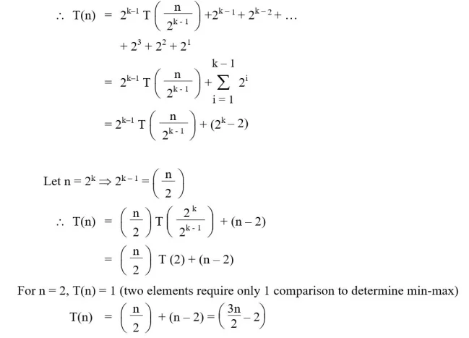
MAX-MIN PROBLEM
After k – 1 iterations

Slide 32
MAX-MIN PROBLEM
It can be observed that divide and conquer approach does only [(3n/2) – 2] comparisons compared to 2(n – 1) comparisons of the conventional approach.

Slide 33
Recurrence and different methods to solve recurrence
Recurrence equation:
Equation that defines a sequence recursively.
T(n) = T(n-1) + n, n>0 -------(1 (recurrence relation))
T(0) = 0 --------(2 (initial condition))
3 methods to solve recurrence equation.

Slide 34
Recurrence equation
Recurrence equation
Substitution method
Master’s method
Recurrence tree method
Forward substitution
Backward substitution

Slide 35
Substitution method
1 forward substitution
Use initial conditional in initial term, use this value to find next term.
Recurrence relation
T(n) = T(n-1) + n Initial condition T(0)=0
Sol.: T(n) = T(n-1) + n -----(1)
If n=1
T(1) = T(0)+1
= 0+1
T(1) = 1 ----(2)

Slide 36
Substitution method
If n=2
T(2) = T(1)+2
= 1+2
T(2) = 3 ----(3)
If n=3
T(3) = T(2)+3
= 3+3
T(3) = 6 ----(4)
By observing,
T(n) = n(n+1)/2
= n²+n/2
= O(n²)
It is difficult to find pattern so generally not used.

Slide 37
Backward substitution method
2. Backward substitution
T(n) = T(n-1) + n -----(1)
If n=n-1
T(n-1) = T(n-1-1)+(n-1)
= T(n-2) + (n-1) ----(2)
Put eq^{n}(2) in eq^{n} (1)
T(n) = T(n-2) + (n-1)+ n ------(3)
let n=n-2
T(n-2) = T(n-1-2)+(n-2)
= T(n-3) + (n-2) ----(4)

Slide 38
Backward substitution method
Put eq^{n}(4) in eq^{n} (3)
T(n) = T(n-3) + (n-2) + (n-1)+ n ------(3)
|
|
T(n) = T(n-k) + (n-k+1) + (n-k+2)+------+ n
Let k=n then,
T(n) = T(n-n) + (n-n+1) + (n-n+2)+------+ n
T(n) = T(0) +1+2+3+------+ n
T(n) = 0 +1+2+3+------+ n
T(n) = n(n+1)/2
= n²+n/2
= O(n²)

Slide 39
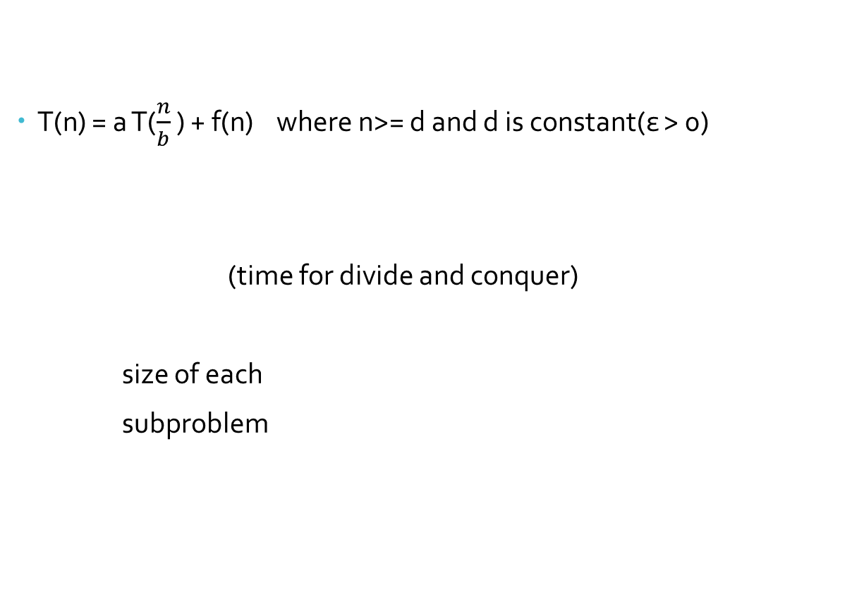
Master’s Method

Slide 40
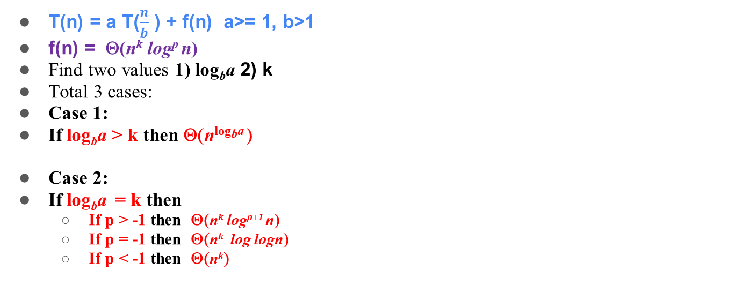
Master’s Method

Slide 41
Master’s Method
Case 3:
If log_{b}a < k then
If p >= 0 then Θ(n^{k} log^{p} n)
If p < 0 then Ο (n^{k})
Ex1 . T(n) = 9T(n/3) + n
a = 9, b = 3, f (n) = θ(n¹log⁰n ), k =1 , p=0
log_{b}a = 2
CASE 1: log_{b}a > k
T(n) = Θ(n²).

Slide 42
Master’s Method
Ex2 . T(n) = 2T(n/3) + 1
a = 2, b = 3 , f (n) = θ( n⁰log⁰n ), k =0 , p=0 and p >-1
log_{b}a = log₃ 2 = n⁰ = 1
CASE 2: log_{b}a = k ,
If p > -1 then Θ(n^{k} log^{p+1} n)
∴ T(n) = Θ(logn).
Ex 3 T(n) = 4T(n/2) + n³
a = 4, b = 2 ,f (n) = θ(n³log⁰n ), k=3, p=0
log_{b}a = 2
CASE 3: log_{b}a < k
If p >= 0 then Θ(n^{k} log^{p} n)
T(n) = Θ(n³).

Slide 43
Recursion tree method
T(n) = 4 T(n/2) + n³
Where n³ = root node
T(n/2) = size of sub-problem
4 = number of sub-problem
Step 1: find cost of each level
Step 2: find depth of tree
Step 3: find number of leaves
There are total 3 cases to solve examples. But case 1 and case 2 are solved by above 3 steps.
Case 1: cost of root node is maximum
Case 2: cost of leaf node is maximum.
Case 3: cost of each level is same.

Slide 44
Recursion tree method
Case 3: cost of each level is same.
Step 1: find cost of each level
Step 2: find depth of tree
Step 3: find level of tree
Step 4: total cost = cost of each level * number of level

Slide 45
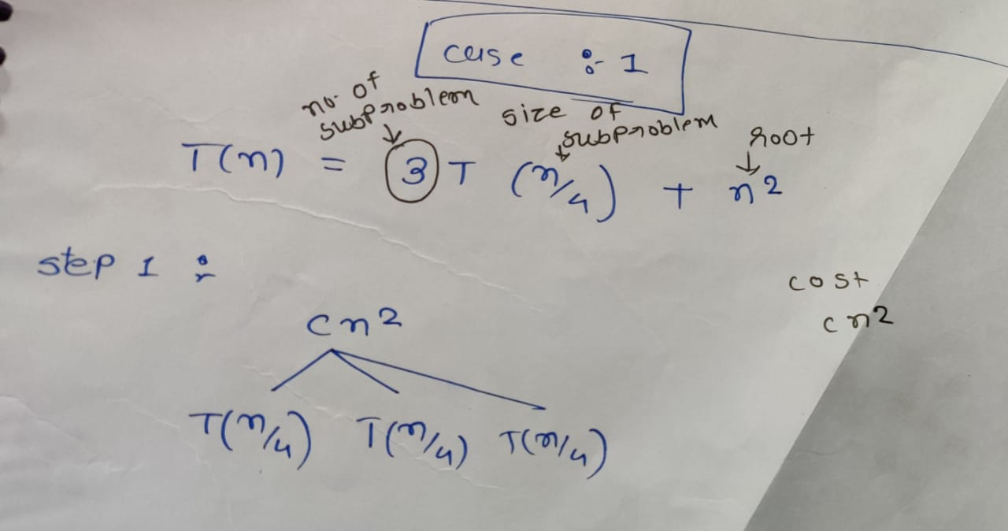
CASE 1: recursion tree

Slide 46
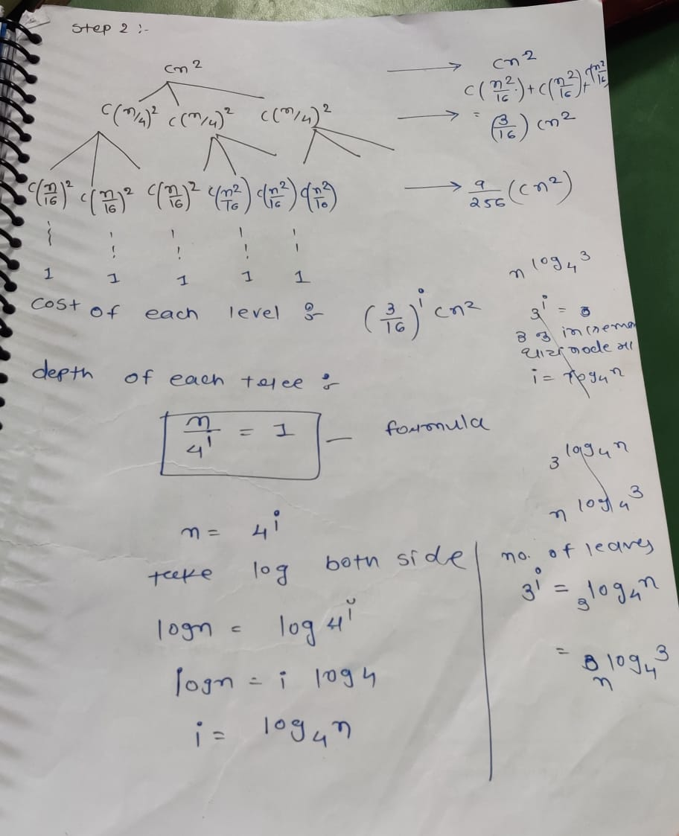
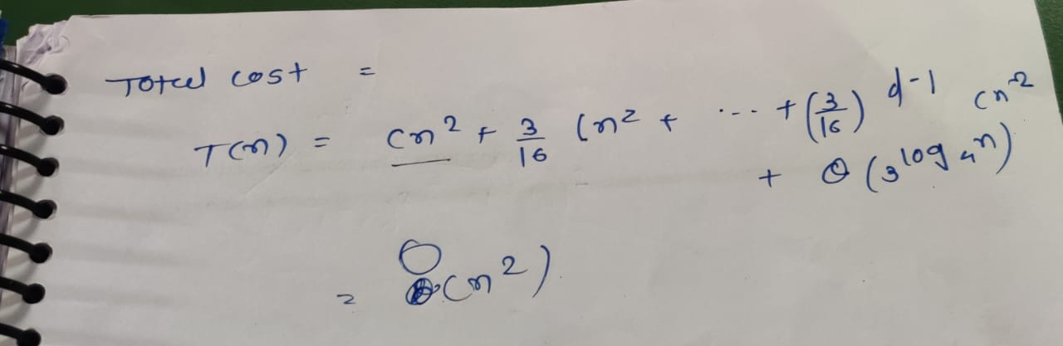

Slide 47
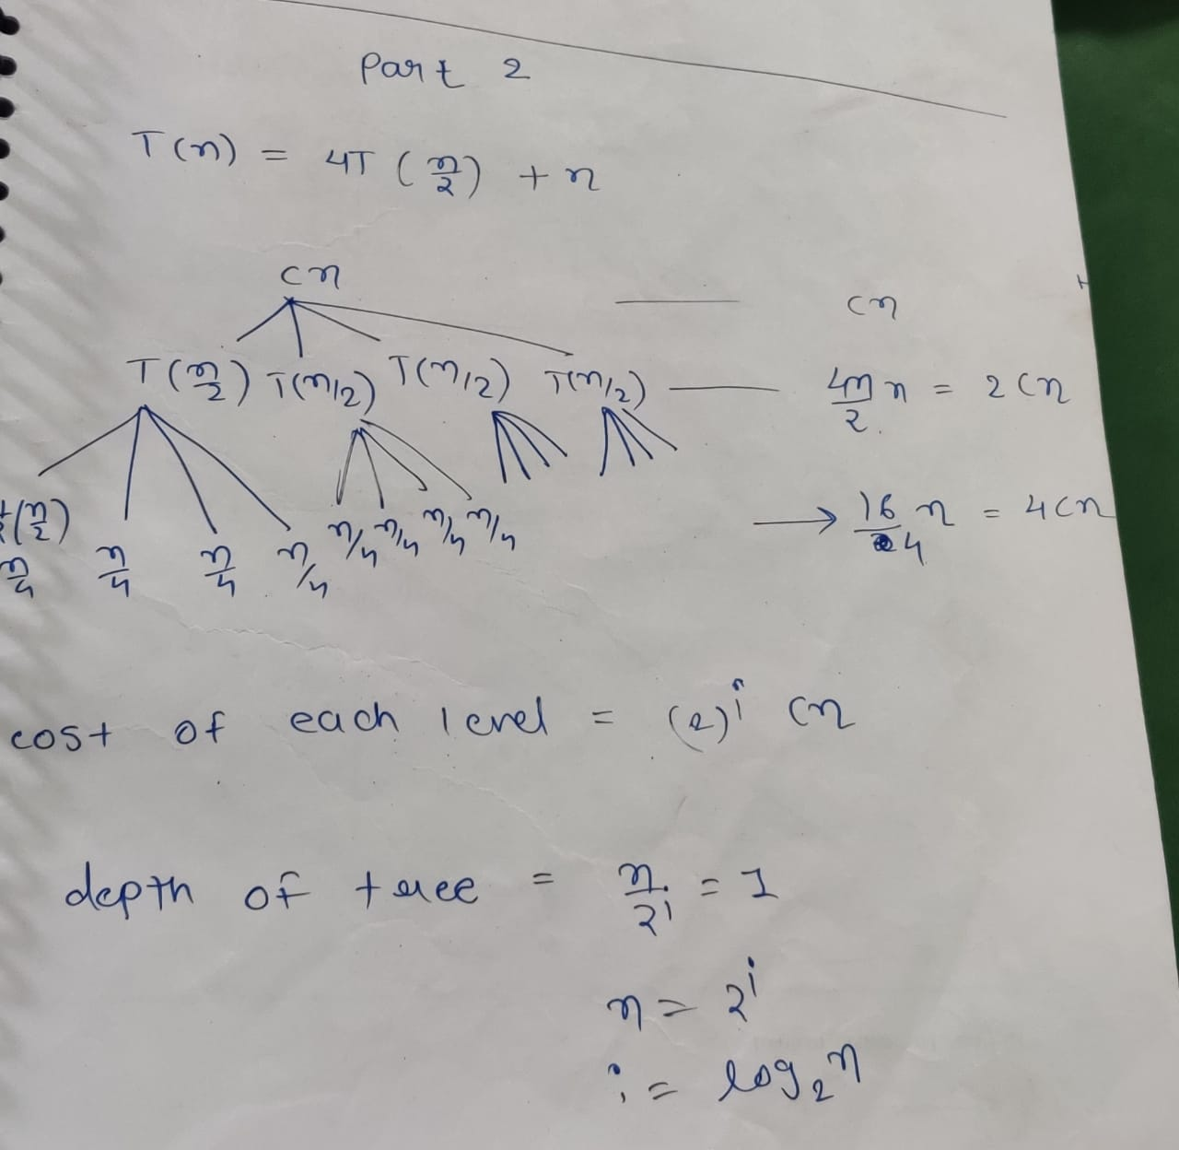
CASE 2: recursion tree

Slide 48
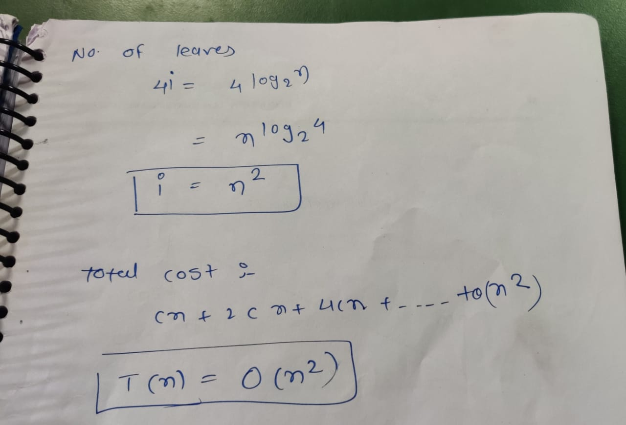

Slide 49
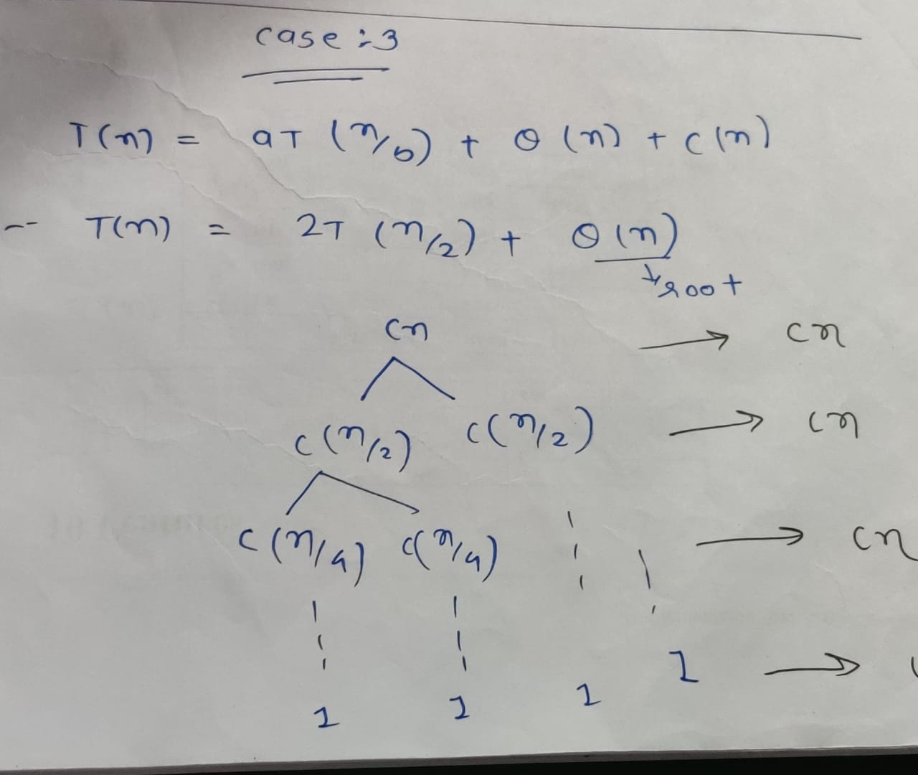
CASE 3: recursion tree

Slide 50
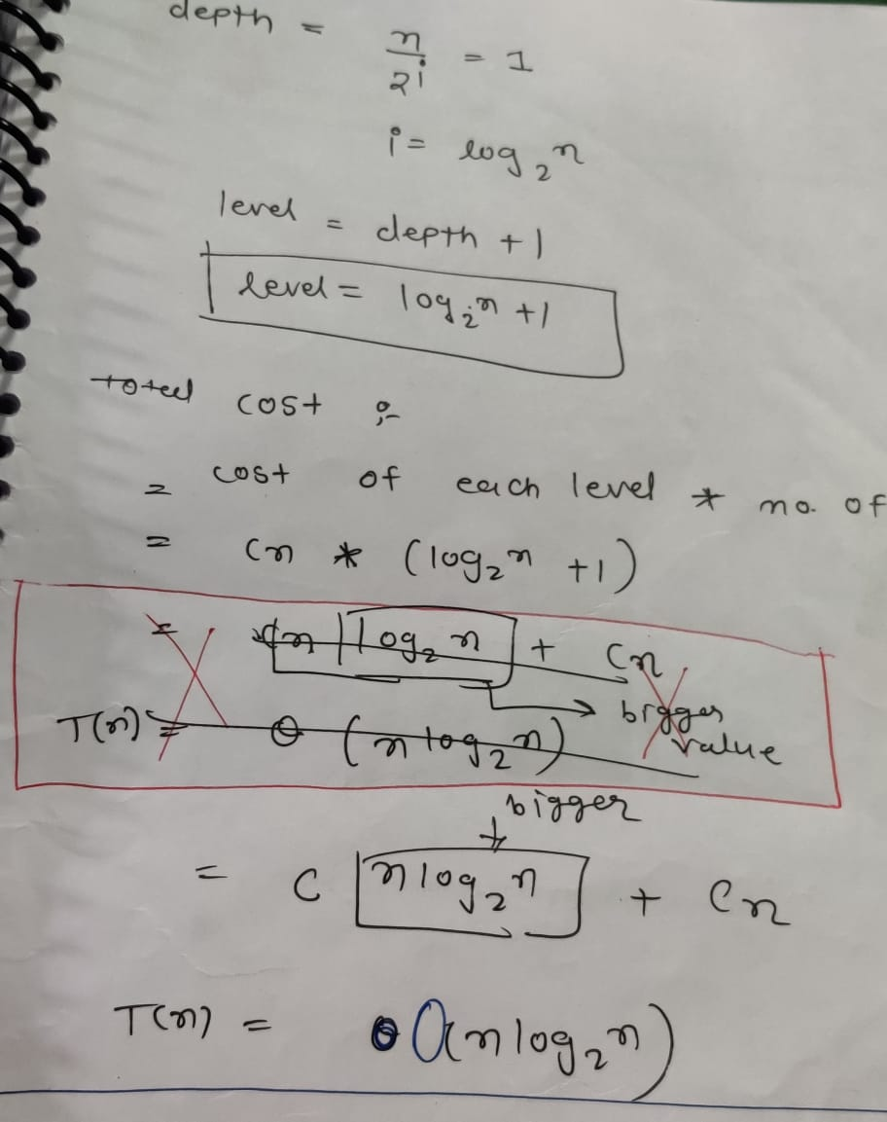

Slide 51
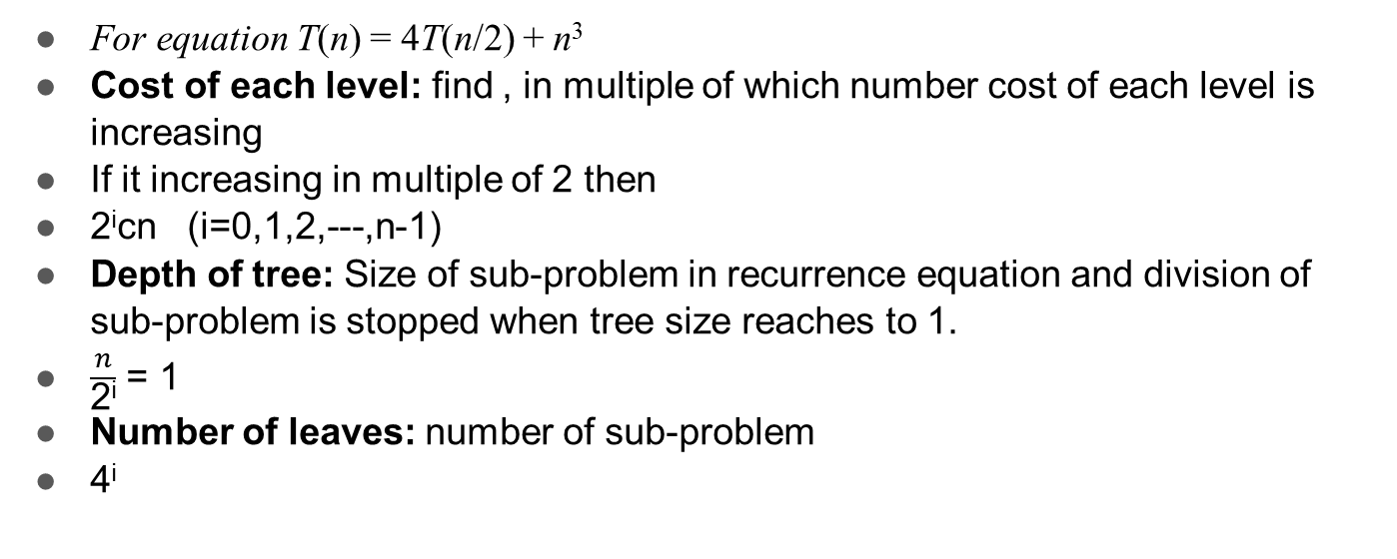
How to find

Slide 52
EXTRA MATERIAL

Slide 53
Multiplying large integers problem
X = 1234
Y= 2345
Divide integer into 2 portion X = a b
where a= 12, b = 34 ( X= 1234)
Y = c d
Where c= 23, d = 45 ( Y= 2345)
X Y = (a * 10^{n/2} + b ) (c * 10^{n/2} + d )
= ac * 10^{n} + (a*d * 10^{n/2})+ (b*c * 10^{n/2})+ bd
= ac * 10^{n} + (ad+ bc) 10^{n/2} + bd
The above procedure still needs four multiplications; ac,ad,bc and bd

Slide 54
Multiplying large integers problem
The key observation is that there is no need to compute both ad and bc; all we really need is the sum of these two terms.
So there is one algorithm which takes only 3 multiplication.
begin
u= (a+b)(c+d)
v=a*c
w=b*d
z= v* 10^{n} + (u-v-w) * 10^{n/2} + w
end

Slide 55
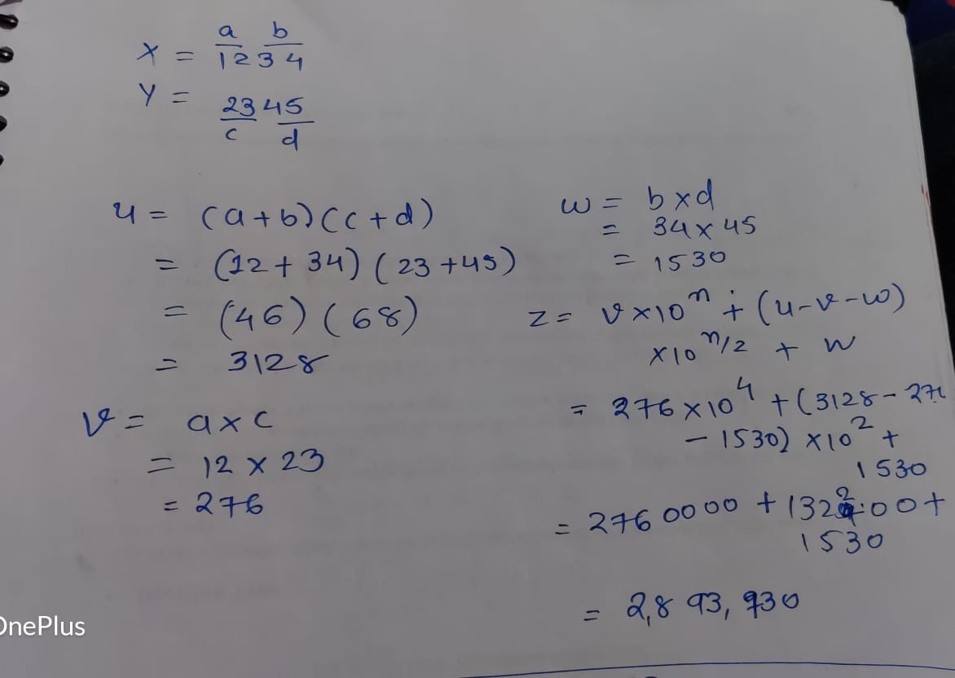

Slide 56
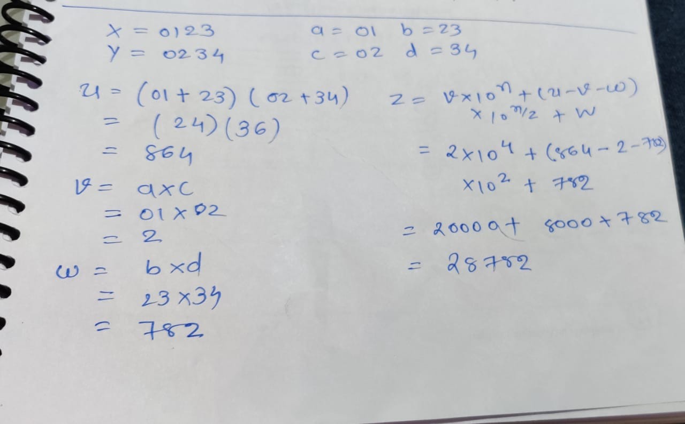

Slide 57
Time complexity
begin
u= (a+b)(c+d)
v=a*c
w=b*d
z= v* 10^{n} + (u-v-w) * 10^{n/2} + w
End
Divide 1 digit into 2 parts so size of sub problem is n/2
So our recurrence equation is
T(n) = 3 T(n/2) + k1 n ------- eq^{n} (1)
divide part-
Total 3 multiplication –
number of sub-problem is 3
Shifting, addition, subtraction– conquer part

Slide 58
Time complexity
Solve this equation by backward substitution
n=n/2 in eqn 1
T(n/2) = 3T(n/4) + k1 n/2 ------(2)
Put eqn(2) in eq(1)
T(n) = 3(3T(n/4) + k1 n/2 ) + k1 n
= 3²T(n/4) + k1n (3/2) + k1 n -------(3)
Put n=n/4 in eqn (1)
T(n/4) = 3T(n/8) + k1 n/4 ------(4)
Put eqn(4) in eq(3)
= 3³T(n/2³) + k1n (3/2)² + k1 n(3/2)+ k1n -------(5)
‘
‘ (upto k we have to find)
= 3^{k}T(n/2^{k}) + k1n [(3/2)² + (3/2)+ 1]
Put n=2^{k}
= 3^{k}T(n/n) + k1n [(1 +(3/2)+ (3/2)² +----+ (3/2) ^{k-1} ]

Slide 59
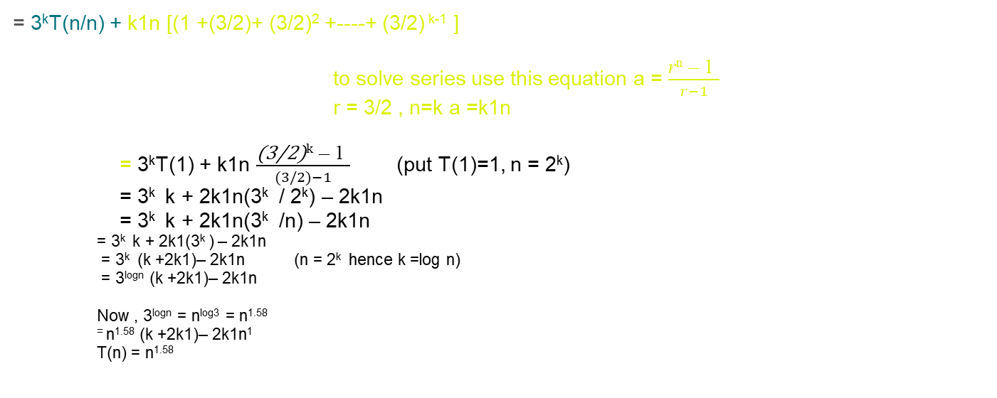
Time complexity

Slide 60
Max Min algorithm
Max_min(A, min, max, low, high)
{
if(low=high) then
max= min= A[low];
else if(low= high-1) then
{
if(A[low]<A[high]) then
{
max = A[high];
min = A[low];
}
else
{
max = A[low];
min = A[high];
}
}

Slide 61
Max Min algorithm
Else
{
mid = (low+high)/2;
Maxmin(low, mid, max, min);
Maxmin(mid+1, max1, min1, high);
if(max< max1) then max=max1;
if(min> min1) then min=min1;
}
}

Slide 62
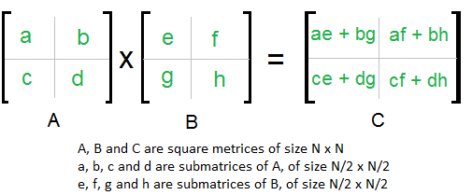
Matrix multiplication
In the above method, we do 8 multiplications for matrices of size N/2 x N/2 and 4 additions. Addition of two matrices takes O(N²) time.
The idea of Strassen’s method is to reduce the number of recursive calls to 7. Strassen’s method is similar to above simple divide and conquer method in the sense that this method also divide matrices to sub-matrices of size N/2 x N/2 as shown in the above diagram, but in Strassen’s method, the four sub-matrices of result are calculated using following formulae.

Slide 63
Addition and Subtraction of two matrices takes O(N²) time. So time complexity can be written as
T(n) = 7T(n/2) + O(n²)
From Master's Theorem, time complexity of above method is O(n^{Log7}) which is approximately O(n^{2.8074})

Slide 64
Merge sort
Mergesort(A[0,--,n-1], low, high)
If(low< high) then
{
mid = (low+high)/2
mergesort(A, low, mid)
mergesort(A, mid+1, high)
combine(A , low, mid, high)
}
Combine(A[0,---,n-1], low, mid, high)
{
k = low #new temp array
i =low #for left sub list
j= mid+1 #for right sub list

Slide 65
While(i<= mid AND j <= high)do
{
if(A[i]= A[j]) then
{
temp[k] = A[i]
i= i+1
k = k+1
}
else
{
temp[k] = A[j]
j= j+1
k = k+1
}
}

Slide 66
While(i<= mid) do
{
temp[k] = A[i]
i= i+1
k = k+1
}
While(j<= high) do
{
temp[k] = A[j]
j= j+1
k = k+1
}
}
When there is only one element left in left sub tree or right tree

Slide 67
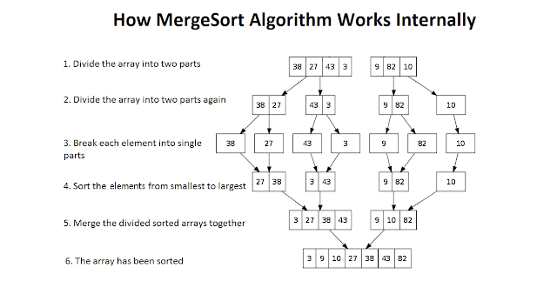
Example of merge sort

Slide 68
Quick sort Algortihm
Quicksort(A[0,--,n-1], low, high)
If(low< high) then
{
m = partition(A[ low….high]) quicksort(A [ low….m-1]))
quicksort(A [ m+1….high]))
}

Slide 69
Quick sort Algortihm
Partition(A[ low….high])
Pivot = A[low]
i= low
J= high
While(i<= j)do
{
while(A[i]<= pivot)do
i= i+1
while(A[j>= pivot)do
j= j+1
if (i<= j) then
swap(A[i], A[j])
}
Swap(A[low], A[j]) # (if j<i)
Return j

Slide 70
Quick sort Algortihm
First of all we take first element and place it at its proper place. We call this element Pivot element.
Note: We can take any element as Pivot element but for convenience the first element is taken as Pivot.
There are two condition to place Pivot at its proper place.
All the elements to the left of Pivot element should be smaller than
All the elements to the right of Pivot element should be greater than
Now we are having two sub part:
Quick sort Left sub tree
Quick sort right sub tree

Slide 71
Time complexity of quick sort and merge sort
T (n) = 2T(n/2)+ n
a=2, b= 2 f(n)= n¹ log⁰p
^{logba} = ^{log22} = 1 k=1 p=0
case : 2
T(n) = θ(n logn)

Slide 72
Exponential
Let a and n be two integers.
We wish to compute x = a^{n}.
If n is small, the obvious algorithm is:
Function expoSeq(a, n) {
r 🡨 a
for i 🡨 1 to n-1 do r 🡨 a*r
return r
}
T(n) = O(n)

Slide 73
Divide and conquer method
With divide and conquer:
a^{n} = return a if n = 1
return (a^{n/2})² if n is even
return a * a^{n-1} otherwise
a²⁹ = a * a²⁸ = a * (a¹⁴)² …….
Which involves only three multiplications and four squaring instead of the 28 multiplication.
a²⁹ = a * a²⁸
= a * (a¹⁴)²
= a * ((a⁷)²)²
= a * (a * (a⁶)²)²
= a * (a * ((a³)²)²)²
= a * (a * ((a * a²)²)²)²
Which involves only three multiplications and four squaring instead of the 28 multiplication

Slide 74
PSEUDOCODE
Function expdc(a,n)
{
if n = 1 then
return a
if n is even then
return (expdc(a^{n/2})² )
else
return( a * expdc(a^{n-1}))
}
T(n) = O(log n)

